Slide 1

DIGITAL LOGIC DESIGN (111776)
Dr. Owais Hussain

Slide 2

Agenda
Sequential Circuits
Synchronous and Asynchronous Types
SR-Latches
Gated SR-Latches
Gated D Latches

Slide 3
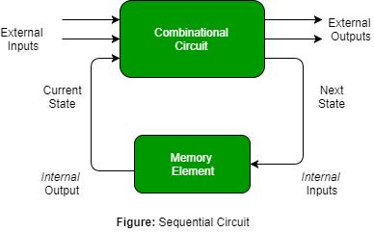
Sample 2
Sequential Circuits
In a Combinational circuit, the output depends upon the Present Input only. In a Sequential circuit, the output depends upon the Present Input as well as the past Output.
We need a memory element to store previous output.
For example, a circuit which adds the input to the previous output.

Slide 4

Sample 2
Sequential Circuits
The memory element can be in many forms (e.g., Flip-flops).
The simplest form is to use a Cascaded NOT gate, meaning 2 NOT gates in series making up a single bit memory cell.
Later, other memory cells were invented including Latches and Flip-Flops.

Slide 5
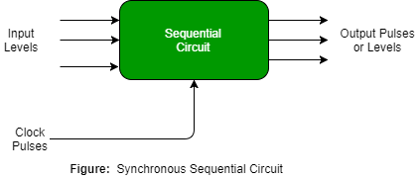
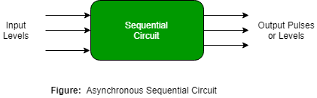
Sample 2
Synchronous and Asynchronous Sequential Circuits
Synchronous sequential circuits are the ones which are attached with a Clock.
They wait for the next clock pulse before performing next operation.
They are slower because they wait for the clock signal, but they are reliable because the internal state is in our control.
Asynchronous sequential circuits only rely on Input signals.
They perform the operation as soon as the input arrives.
They are faster because they do not wait for clock signal but can run into race condition because the internal state is not in control.
Notes:
Race condition is a state when a circuit has multiple inputs waiting but the circuit is slow, or when it performs an input faster and moves to the next input out of desired sequence.

Slide 6
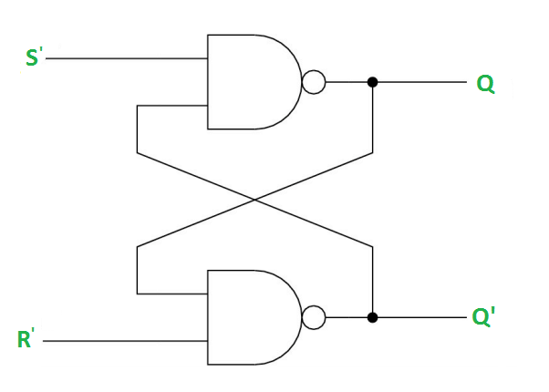
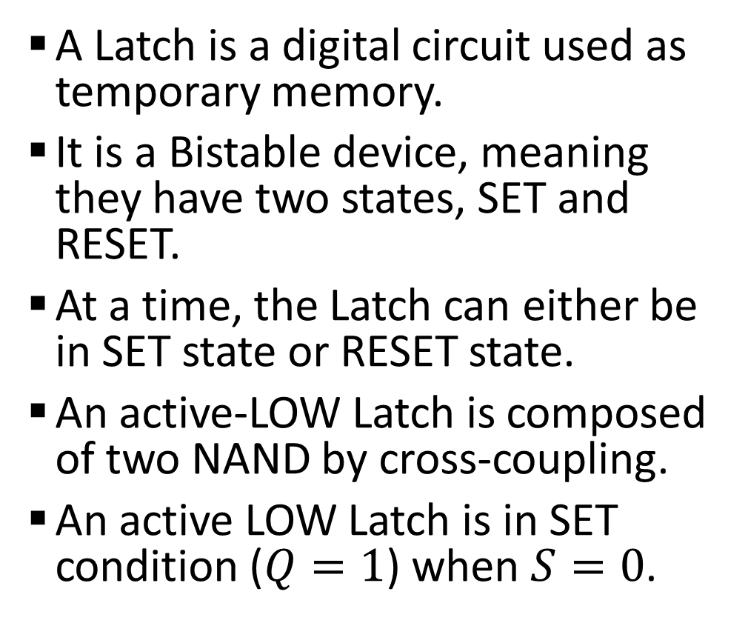
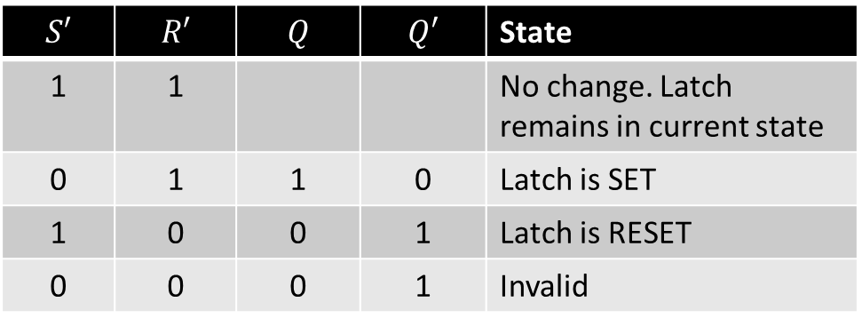
Sample 2
SR-Latches
A Latch is a digital circuit used as temporary memory.
It is a Bistable device, meaning they have two states, SET and RESET.
At a time, the Latch can either be in SET state or RESET state.
An active-LOW Latch is composed of two NAND by cross-coupling.
An active LOW Latch is in SET condition ($Q=1$) when $S=0$.
$$S′$$ | $$R′$$ | $$Q$$ | $$Q′$$ | State
1 | 1 |  |  | No change. Latch remains in current state
0 | 1 | 1 | 0 | Latch is SET
1 | 0 | 0 | 1 | Latch is RESET
0 | 0 | 0 | 1 | Invalid

Slide 7
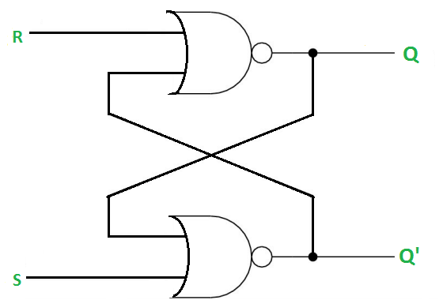
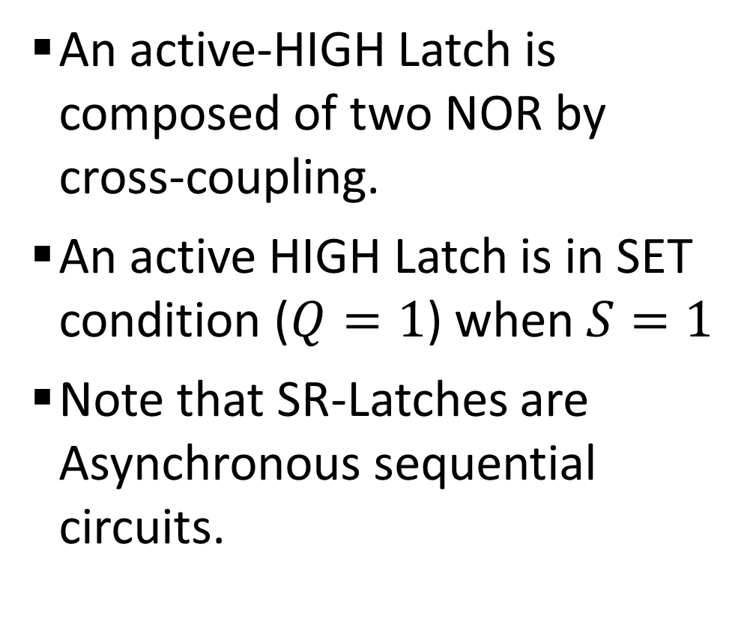
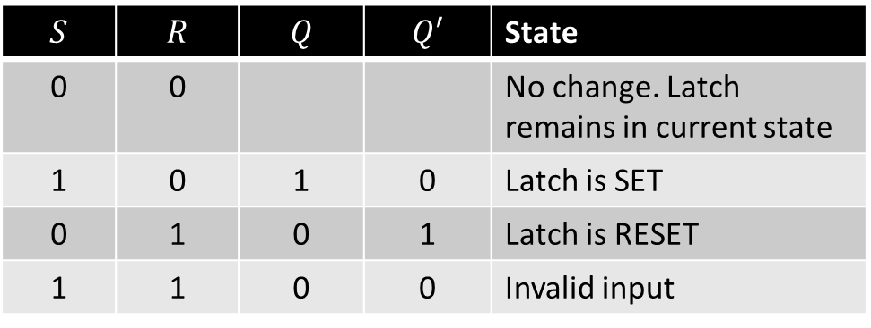
Sample 2
SR-Latches
An active-HIGH Latch is composed of two NOR by cross-coupling.
An active HIGH Latch is in SET condition ($Q=1$) when $S=1$
Note that SR-Latches are Asynchronous sequential circuits.
$$S$$ | $$R$$ | $$Q$$ | $$Q′$$ | State
0 | 0 |  |  | No change. Latch remains in current state
1 | 0 | 1 | 0 | Latch is SET
0 | 1 | 0 | 1 | Latch is RESET
1 | 1 | 0 | 0 | Invalid input

Slide 8
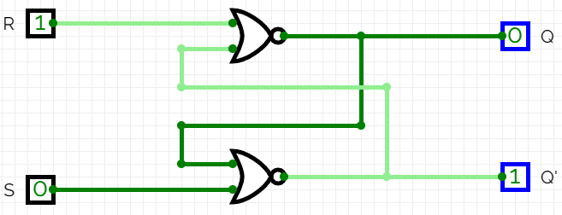
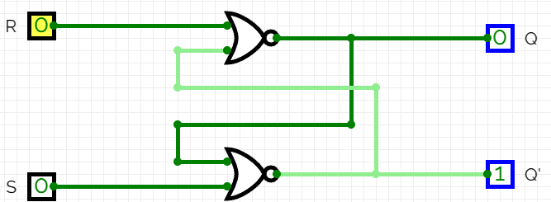
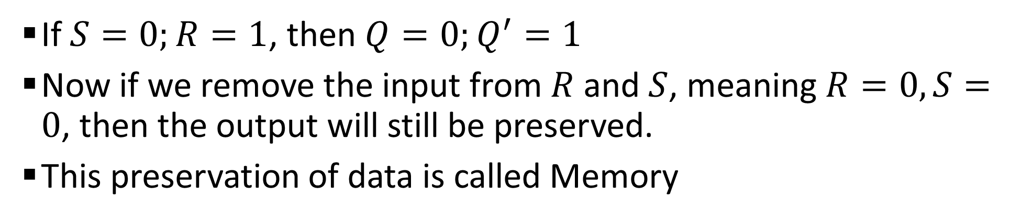
Sample 2
SR-Latches – Case 1
If $S=0;R=1$, then $Q=0;Q^{′}=1$
Now if we remove the input from $R$ and $S$, meaning $R=0,S=0$, then the output will still be preserved.
This preservation of data is called Memory

Slide 9
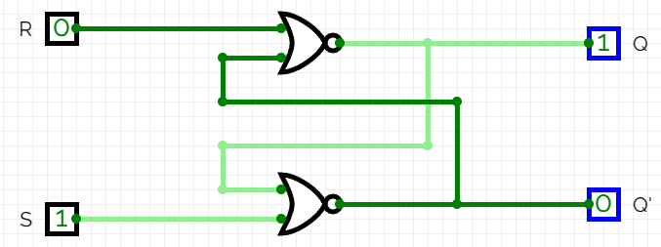
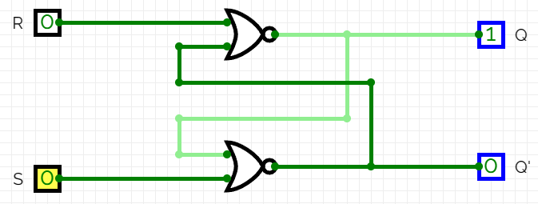
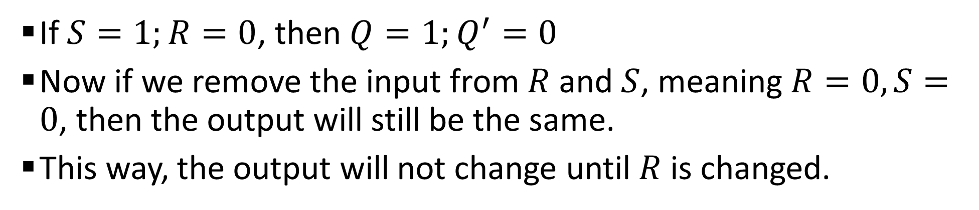
Sample 2
SR-Latches – Case 2
If $S=1;R=0$, then $Q=1;Q^{′}=0$
Now if we remove the input from $R$ and $S$, meaning $R=0,S=0$, then the output will still be the same.
This way, the output will not change until $R$ is changed.

Slide 10
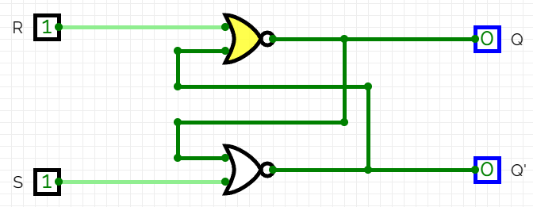
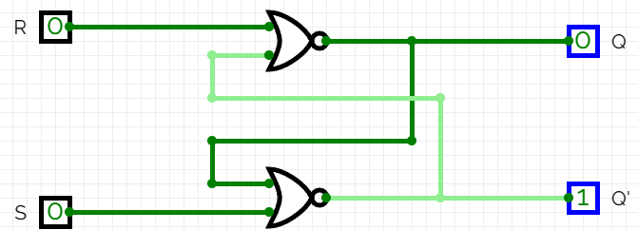
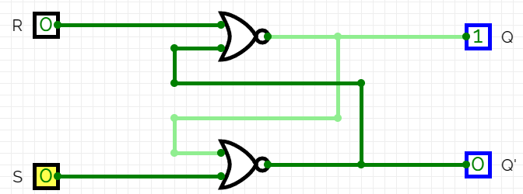
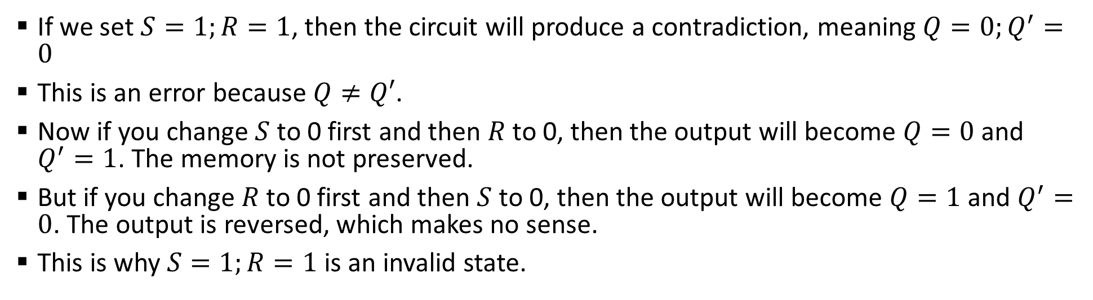
Sample 2
SR-Latches – Case 3
If we set $S=1;R=1$, then the circuit will produce a contradiction, meaning $Q=0;Q^{′}=0$
This is an error because $Q≠Q′$.
Now if you change $S$ to 0 first and then $R$ to 0, then the output will become $Q=0$ and $Q^{′}=1$. The memory is not preserved.
But if you change $R$ to 0 first and then $S$ to 0, then the output will become $Q=1$ and $Q^{′}=0$. The output is reversed, which makes no sense.
This is why $S=1;R=1$ is an invalid state.

Slide 11

Sample 2
Activity 3
The given SR-Latch cases are of active-HIGH Latches. Create the same 3 cases for active-LOW SR-Latches.
You must show simulation of all cases before and after changing the values of $R$ and $S$.

Slide 12
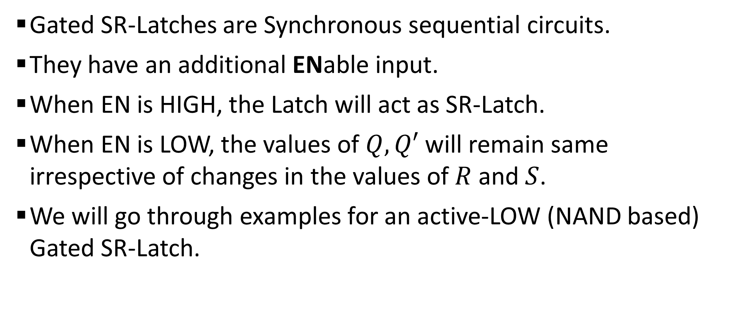
Sample 2
Gated SR-Latches
Gated SR-Latches are Synchronous sequential circuits.
They have an additional ENable input.
When EN is HIGH, the Latch will act as SR-Latch.
When EN is LOW, the values of $Q,Q′$ will remain same irrespective of changes in the values of $R$ and $S$.
We will go through examples for an active-LOW (NAND based) Gated SR-Latch.

Slide 13
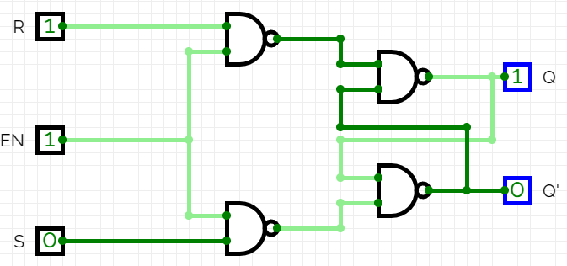
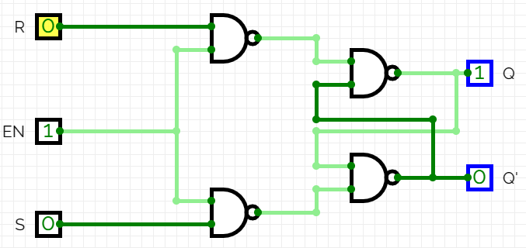
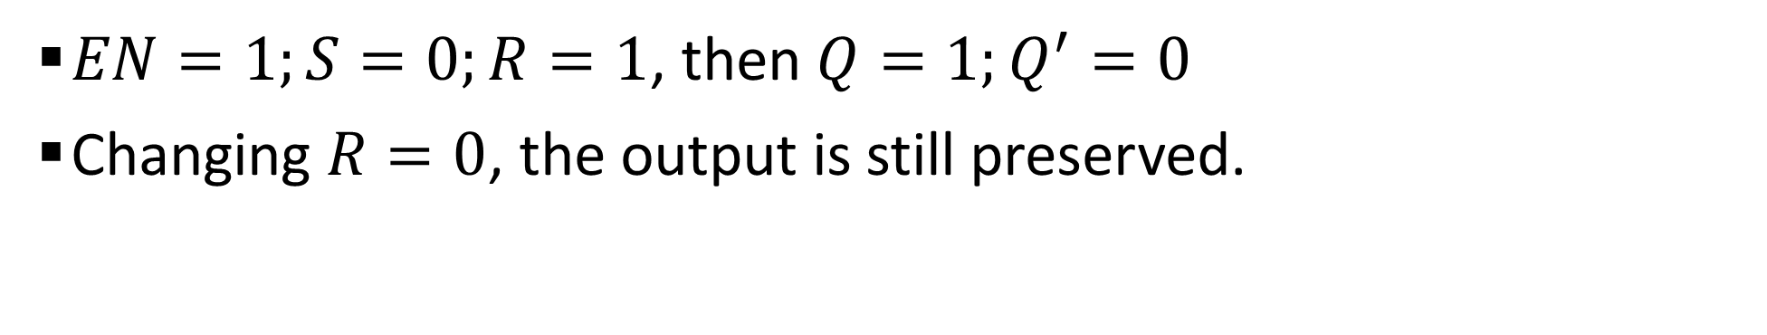
Sample 2
Gated SR-Latches – Case 1
$EN=1;S=0;R=1$, then $Q=1;Q^{′}=0$
Changing $R=0$, the output is still preserved.

Slide 14
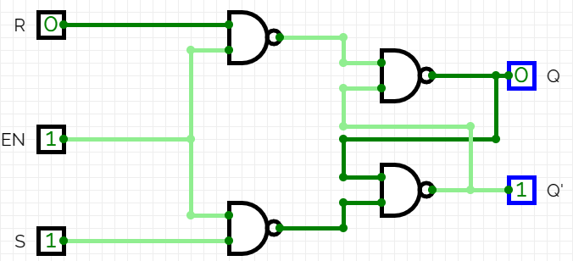
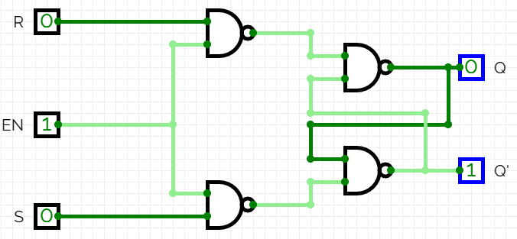
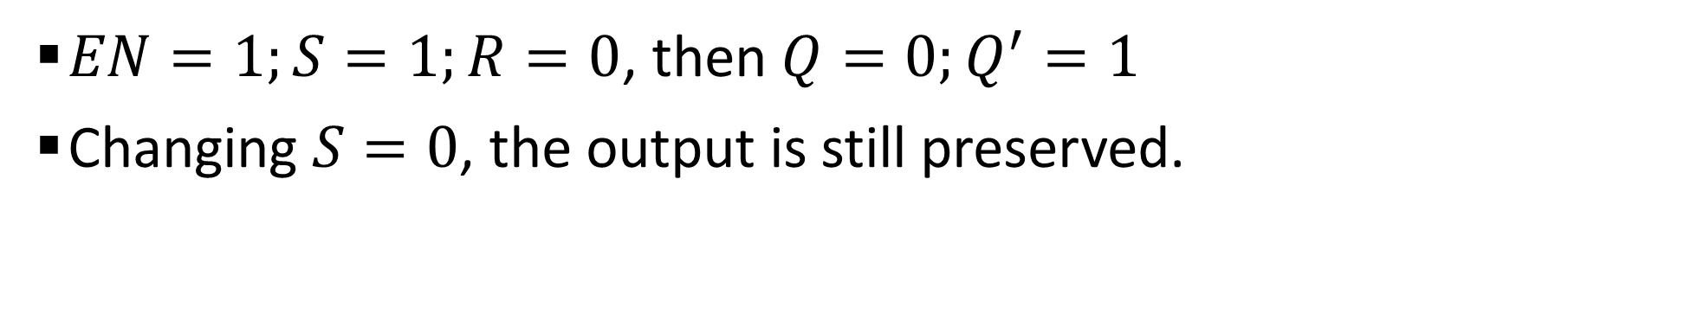
Sample 2
Gated SR-Latches – Case 2
$EN=1;S=1;R=0$, then $Q=0;Q^{′}=1$
Changing $S=0$, the output is still preserved.

Slide 15
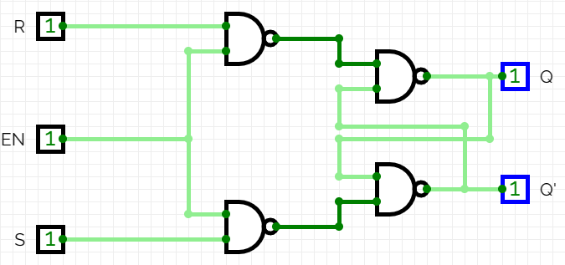
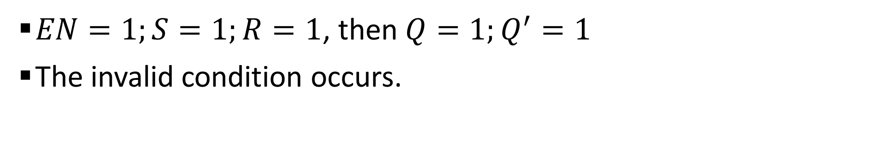
Sample 2
Gated SR-Latches – Case 3
$EN=1;S=1;R=1$, then $Q=1;Q^{′}=1$
The invalid condition occurs.

Slide 16
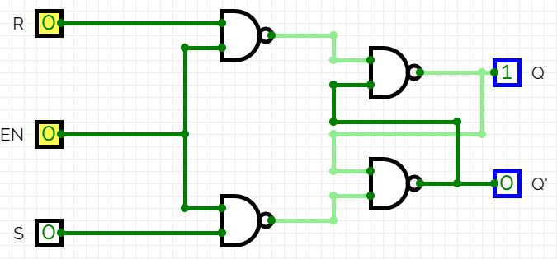
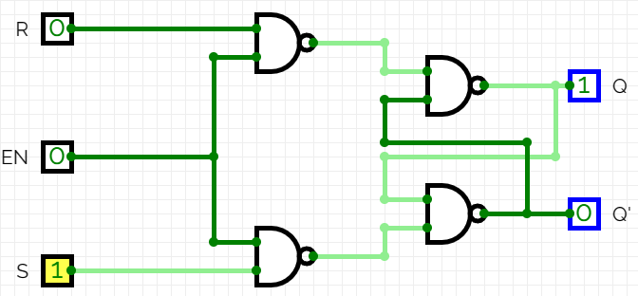
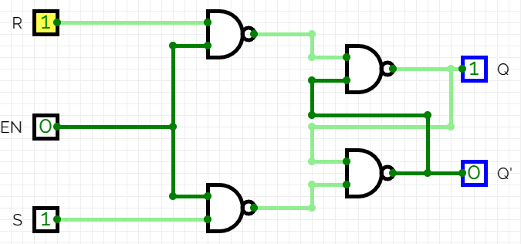
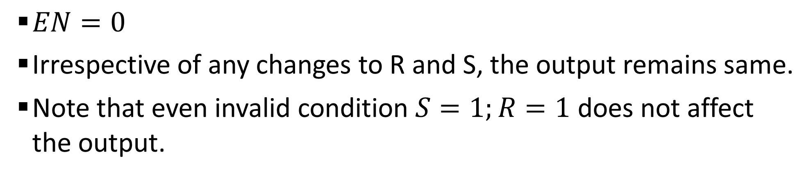
Sample 2
Gated SR-Latches – Case 4
$EN=0$
Irrespective of any changes to R and S, the output remains same.
Note that even invalid condition $S=1;R=1$ does not affect the output.

Slide 17
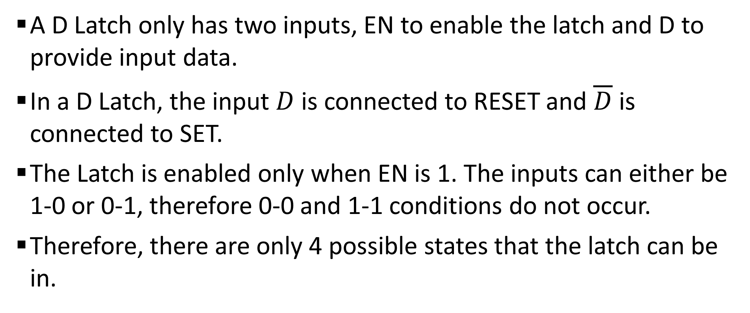
Sample 2
D Latches (Gated)
A D Latch only has two inputs, EN to enable the latch and D to provide input data.
In a D Latch, the input $D$ is connected to RESET and $\overline{D}$ is connected to SET.
The Latch is enabled only when EN is 1. The inputs can either be 1-0 or 0-1, therefore 0-0 and 1-1 conditions do not occur.
Therefore, there are only 4 possible states that the latch can be in.

Slide 18
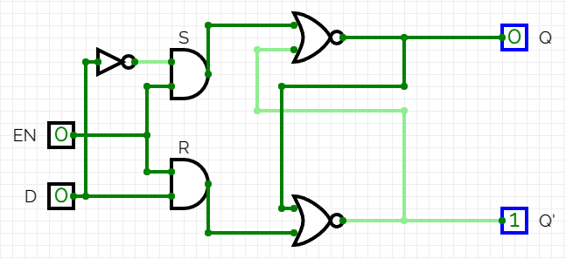
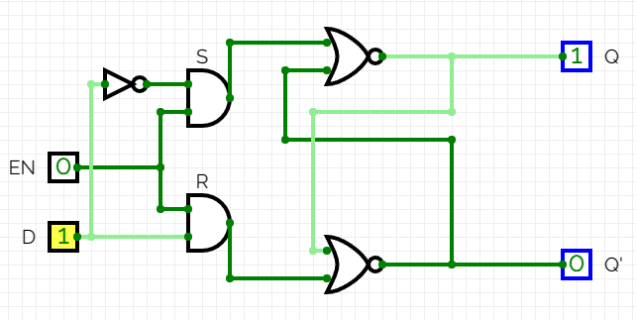
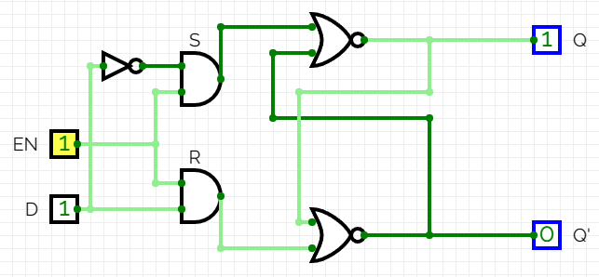
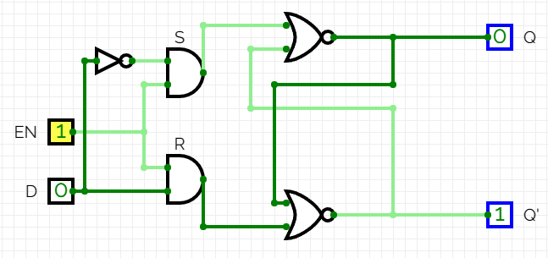
Sample 2
D Latches – All 4 states

Slide 19



THANK YOU
Owais Hussain
+92 345-3174270
owais.hussain@kiet.edu.pk
https://www.researchgate.net/profile/Owais-Hussain-3

